Slide 1

CSE- 104
Structured Programming Lab
Lab : 10 File in C, Recursion (Basic)
Fahad Ahmed
Lecturer, Dept. of CSE
E-mail: fahadahmed@uap-bd.edu

Slide 2
File
A file represents a sequence of bytes on the disk where a group of related data is stored. File is created for permanent storage of data. It is a ready made structure.
In C language, we use a structure pointer of file type to declare a file.
How to Create a File
Whenever you want to work with a file, the first step is to create a file. A file is nothing but space in a memory where data is stored.
To create a file in a 'C' program following syntax is used,
FILE *fp;
fp = fopen ("file_name", "mode");

Slide 3
FILE
fp is a pointer of FILE type and FILE is a structure that store following information about opened file.
typedef struct {
int level; /* fill/empty level of buffer */
unsigned flags; /* File status flags */
char fd; /* File descriptor */
unsigned char hold; /* Ungetc char if no buffer */
int bsize; /* Buffer size */
unsigned char *buffer; /* Data transfer buffer */
unsigned char *curp; /* Current active pointer */
unsigned istemp; /* Temporary file indicator */
short token; /* Used for validity checking */
}FILE;

Slide 4
File
'C' provides following file management functions,
Creation of a file
Opening a file
Reading a file
Writing to a file
Closing a file
The most important file management functions
function | purpose
fopen () | Creating a file or opening an existing file
fclose () | Closing a file
fprintf () | Writing a block of data to a file
fscanf () | Reading a block data from a file
getc () | Reads a single character from a file
putc () | Writes a single character to a file
getw () | Reads an integer from a file
putw () | Writing an integer to a file
fseek () | Sets the position of a file pointer to a specified location

Slide 5
File
Whenever you open or create a file, you have to specify what you are going to do with the file. A file in 'C' programming can be created or opened for reading/writing purposes. A mode is used to specify whether you want to open a file for any of the below-given purposes.
mode | description
r | opens a text file in reading mode
w | opens or create a text file in writing mode.
a | opens a text file in append mode
r+ | opens a text file in both reading and writing mode
w+ | opens a text file in both reading and writing mode
a+ | opens a text file in both reading and writing mode
rb | opens a binary file in reading mode
wb | opens or create a binary file in writing mode

Slide 6
File
How to Create a File
The syntax for opening a file in standard I/O is:
ptr = fopen("fileopen","mode");
For example,
fopen("E:\cprogram\newprogram.txt","w");
Closing a file is performed using the fclose() function.
fclose(fptr);

Slide 7
File: Write to a text file
#include <stdio.h>
#include <stdlib.h>
int main()
{
int num;
FILE *fptr;
fptr = fopen("abc.txt","w");
if(fptr == NULL)
{
printf("Error!");
exit(1);
}
else printf("file has been created\n");
printf("Enter num: ");
scanf("%d",&num);
fprintf(fptr,"%d",num);
fclose(fptr);
return 0;
}

Slide 8
File: Read from a text file
#include <stdio.h>
#include <stdlib.h>
int main()
{
int num;
FILE *fptr;
if ((fptr = fopen("abc.txt","r")) == NULL)
{
printf("Error! opening file");
exit(1);
}
else printf("file opened and reading from it\n");
fscanf(fptr,"%d", &num);
printf("Value of n = %d\n\n", num);
fclose(fptr);
return 0;
}

Slide 9
File: Write to a text file
Write a c program to write your full name in a text file.

Slide 10
File: Write to a text file
#include <stdio.h>
#include <stdlib.h>
int main()
{
char sentence[1000];
FILE *fptr;
fptr = fopen("abc.txt","w");
// exiting program
if (fptr == NULL)
{
printf("Error!");
exit(1);
}
printf("Enter a sentence:\n");
fgets(sentence, sizeof(sentence), stdin);
fprintf(fptr, "%s", sentence);
fclose(fptr);
return 0;
}

Slide 11
File: Read from a text file
Write a c program to read your full name from text file and display it.

Slide 12
File: Read from a text file
#include <stdio.h>
#include <stdlib.h>
int main() {
char c[1000];
FILE *fptr;
if ((fptr = fopen("abc.txt","r")) == NULL) {
printf("Error! opening file");
exit(1);
}
fscanf(fptr, "%[^\n]", c);
printf("Data from the file:\n%s", c);
fclose(fptr);
return 0;
}

Slide 13
File: Write to a text file
Write a c program to reading value of different types of data .
Like
int float char double

Slide 14
File: Write to a text file
#include <stdio.h>
main(){
FILE *fp;
int a;
float b;
char c;
double d;
fp = fopen("abc.txt","r");
if(fp == NULL) {
printf("Error....");
return;
}
fscanf(fp,"%d %f %c %lf",&a,&b,&c,&d);
printf("a = %d b = %f c = %c d = %lf",a,b,c,d);
fclose(fp);
}

Slide 15
File: Copying content
Write a c program for Copying content of one text file to another text file

Slide 16
File: Copying content
#include <stdio.h>
main()
{
FILE *fp1,*fp2;
char ch;
fp1 = fopen("aa.txt","r");
fp2 = fopen("bb.txt","w");
if(fp1 == NULL || fp2 == NULL)
{
printf("Error....");
return;
}
while(1)
{
fscanf(fp1,"%c",&ch);
if(feof(fp1)) break;
fprintf(fp2,"%c",ch);
}
fclose(fp1);
fclose(fp2);
}

Slide 17
File: append data into a file
Write a c program to append data into a file

Slide 18
File: append data into a file
#include <stdio.h>
int main ()
{
FILE * fptr;
int i,n;
char str[100];
char fname[20];
char str1;
printf(" Input the file name to be opened : ");
scanf("%s",fname);
fptr = fopen(fname, "a");
printf(" Input the number of lines to be written : ");
scanf("%d", &n);
printf(" The lines are : \n");
for(i = 0; i < n+1; i++)
{
fgets(str, sizeof str, stdin);
fputs(str, fptr);
}
fclose (fptr);
fclose (fptr);
fptr = fopen (fname, "r");
printf("\n The content of the file %s is :\n",fname);
str1 = fgetc(fptr);
while (str1 != EOF)
{
printf ("%c", str1);
str1 = fgetc(fptr);
}
printf("\n\n");
fclose (fptr);
return 0;
}

Slide 19
File: Home Task
Write a c program to read numbers from a file and check those numbers even or odd.
Finally save this data different file name even.txt and odd.txt.

Slide 20


Recursion

Slide 21

C Recursion

Slide 22
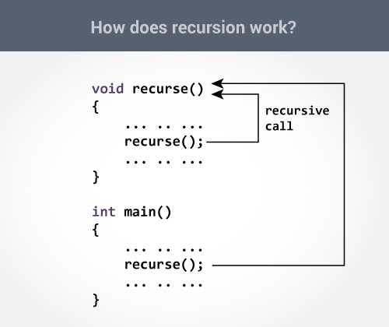
C Recursion
A function that calls itself is known as a recursive function. And, this technique is known as recursion.

Slide 23
Sum of Natural Numbers Using Recursion
#include <stdio.h>
int sum(int num)
{
if (num!=0)
return num + sum(num-1);
else
return num;
}
int main()
{
int number, result;
printf("Enter a positive integer: ");
scanf("%d", &number);
result = sum(number);
printf("sum=%d", result);
}

Slide 24
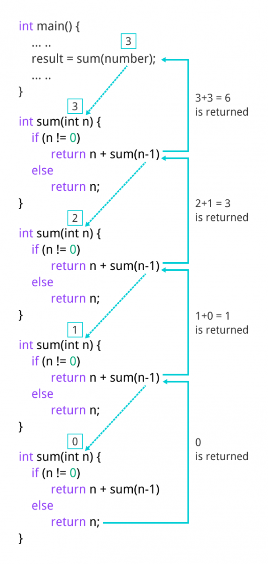
Sum of Natural Numbers Using Recursion

Slide 25
factorial
#include <stdio.h>
int factorial(int n) {
if (n == 1)
return 1;
else
return (n * factorial(n-1));
}
int main(){
int n,result;
printf("Enter the value of n: ");
scanf("%d",&n);
result = factorial(n);
printf("Factorial is : %d",result);
return 0;
}
factorial(3) = 3 * factorial(2) 3 * 2 * factorial(1) 3 * 2 * 1 = 6

Slide 26
factorial

Slide 27
রিকার্সিভ ফাংশন
https://hellohasan.com/2016/11/11/%e0%a6%b0%e0%a6%bf%e0%a6%95%e0%a6%be%e0%a6%b0%e0%a7%8d%e0%a6%b8%e0%a6%bf%e0%a6%ad-%e0%a6%ab%e0%a6%be%e0%a6%82%e0%a6%b6%e0%a6%a8-recursive-function-recursion/?relatedposts_hit=1&relatedposts_origin=2261&relatedposts_position=2
https://jakir.me/%E0%A6%B0%E0%A6%BF%E0%A6%95%E0%A6%BE%E0%A6%B0%E0%A6%B6%E0%A6%A8-recursion/
http://www.shafaetsplanet.com/?p=1022

Slide 28
Home Work
Write a program in C to find GCD of two numbers using recursion.
Write a program in C to Print Fibonacci Series using recursion.
Solution: https://www.w3resource.com/c-programming-exercises/recursion/index.php

Slide 29

Thanks to All

